Slide 1
CINEMA SEAT BOOKING SYSTEM
NAME :
S.VEENA AKSHAYA(2620090069)
K.V.N.BRUNDHA GEETHIKA(2620080031)

Slide 2

Outline :
Introduction
Abstract
Understanding the Problem Statement
CO-1: Java Fundamentals
CO-2: Control Flow Statements
CO-3: Methods and Arrays
CO-4: Strings
CO-5: Exception Handling
CO-6: StringBuffer
Project Output Screenshots
Conclusion
GitHub Link

Slide 3

Introduction :
The Cinema Seat Booking System simplifies the process of booking movie tickets. Users can select a movie, check seat availability, book seats, and purchase snacks. The system calculates the total amount and displays the booking details.

Slide 4

Abstract :
The Smart Cinema Seat Booking System is a Java-based application that allows users to select movies, book seats, and choose snacks. It calculates the ticket cost and generates the final bill. The project demonstrates Java concepts such as data types, conditional statements, loops, classes, objects, methods, arrays, and string operations.

Slide 5

Problem Statement :
Manual cinema ticket booking can be time-consuming and may lead to confusion regarding seat availability, ticket prices, and snack orders.
Proposed Solution :
The Cinema Seat Booking System provides a simple menu-driven Java application that allows users to:
View available movies and ticket prices.
Select a movie and seat.
Check whether a seat is already booked.
Choose snacks and calculate the total amount.
View booking confirmation and a booking summary.
Objective: To demonstrate how Java programming can be used to manage a basic cinema ticket booking process.

Slide 6
CO-1 — Data Types, Variables, Operators and Input/Output :
Primitive Data Types: int, double, char, and boolean store different values.
Reference Data Types: String, Scanner, StringBuffer, and arrays store text, input objects, booking details, and data.
Variables and Scope: Variables such as choice, total, and customerName store booking information.
Operators: Arithmetic, relational, logical, and assignment operators perform calculations and validations.
Input/Output: Scanner accepts customer input, while System.out.println() displays information.
Application: These concepts collect customer details and calculate ticket costs.

Slide 7
CO-2 — Control Flow Statements :
if Statement: Checks whether the user wants to continue booking.
if-else Statement: Checks whether a selected seat is already booked.
Nested-if: Validates seat rows and columns.
if-else-if Ladder: Validates the selected movie.
switch Statement: Handles snack selection.
default and break: Handle invalid snack choices and control execution.
while Loop: Repeats the booking process.
for Loop: Displays movies and seat layouts.
continue: Skips the remaining booking steps when a seat is unavailable.
Nested Loops: Display the cinema seating arrangement row by row.
Compound Statements: Group related statements using curly braces.
Application: Control flow manages user choices, validates inputs, and repeats the booking process.

Slide 8
CO-3 — Methods, Recursion and Arrays :
Modular Programming: Divides the program into separate methods.
Method Definition and Invocation: displayMovies(), displaySeats(), and countAvailableSeats() perform specific tasks.
Return Values: countAvailableSeats() returns the number of available seats.
1D Arrays: movies[] stores movie names, while prices[] stores ticket prices.
2D Arrays: seats[][] represents the cinema seating arrangement.
Array Traversal: Loops access movie and seat information.
Enhanced for-each Loop: Traverses rows and seats when counting available seats.
Counting Techniques: Counts the seats that remain available.
Application: Methods and arrays organize movie details and track seat availability.

Slide 9
CO-4 — Strings :
String Declaration: String customerName stores the customer's name.
String Arrays: movies[] stores the names of available movies.
trim(): Removes leading and trailing spaces from input.
isEmpty(): Checks whether the customer name is empty.
toUpperCase(): Displays the movie name in uppercase.
charAt(): Extracts the snack selection character.
String Concatenation: The + operator combines text with booking details.
Application: String operations process customer information and display readable booking confirmations.

Slide 10
CO-5 — Exception Handling :
try Block: Contains the main booking operations.
catch Block: Handles errors that occur during execution.
NumberFormatException: Handles invalid numeric input when converting text to numbers.
IllegalArgumentException: Handles invalid movie selections, seat coordinates, and empty customer names.
finally Block: Displays the final message, shows available seats, and closes the Scanner.
Application: Exception handling helps the program respond to invalid inputs instead of terminating unexpectedly for the handled errors.

Slide 11
CO-6 — StringBuffer :
StringBuffer Declaration: StringBuffer bookingSummary stores booking details.
Object Creation: new StringBuffer() creates a mutable string object.
append() Method: Adds customer name, movie, seat, snack, and total amount to the summary.
Mutable Strings: Allows the summary to be updated as new details are added.
Displaying the Summary: Prints the collected booking information at the end.
Application: StringBuffer builds a booking summary containing the details of successful bookings.

Slide 12

Output :
The program displays:
Customer name
Available movies and ticket prices
Selected movie
Seat availability
Booked seat numbers
Ticket cost
Selected snacks and snack cost
Final amount
Booking confirmation

Slide 13
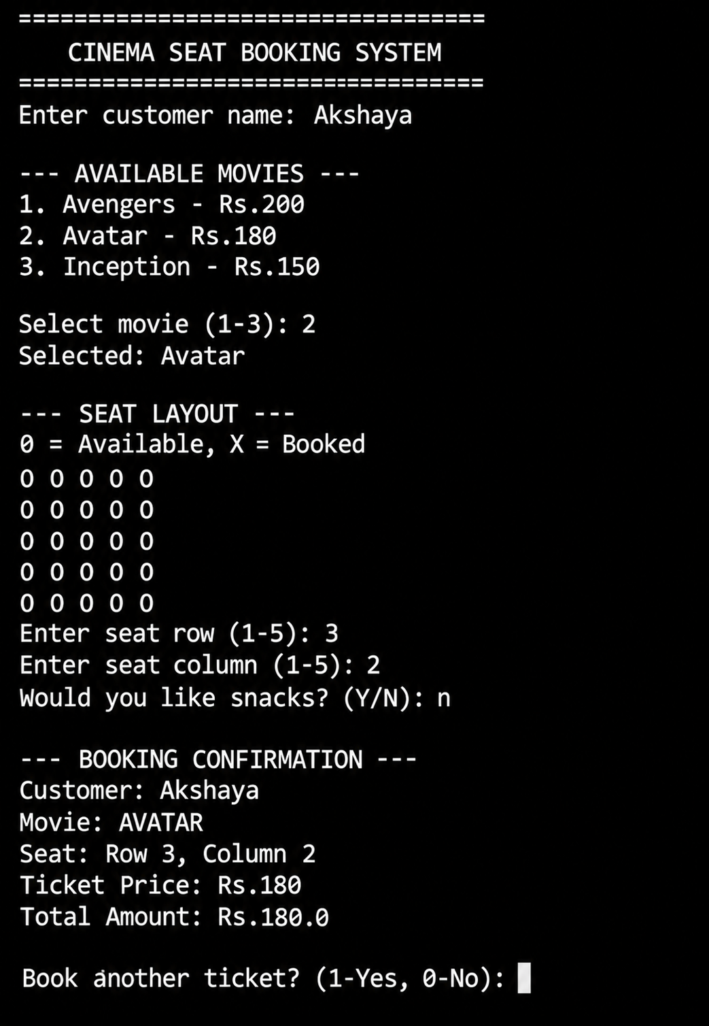
Screenshot :

Slide 14

Conclusion :
The Smart Cinema Seat Booking System demonstrates the practical use of Java programming. It uses data types, variables, operators, conditional statements, loops, classes, objects, methods, and arrays to manage movie ticket bookings and calculate the final bill.

Slide 15
GitHub Link :
https://github.com/group5cinemaseatbookingsystem-lang/KLH_2026_T5_CINEMASEATBOOKINGSYSTEM

Slide 16


